Slide 1
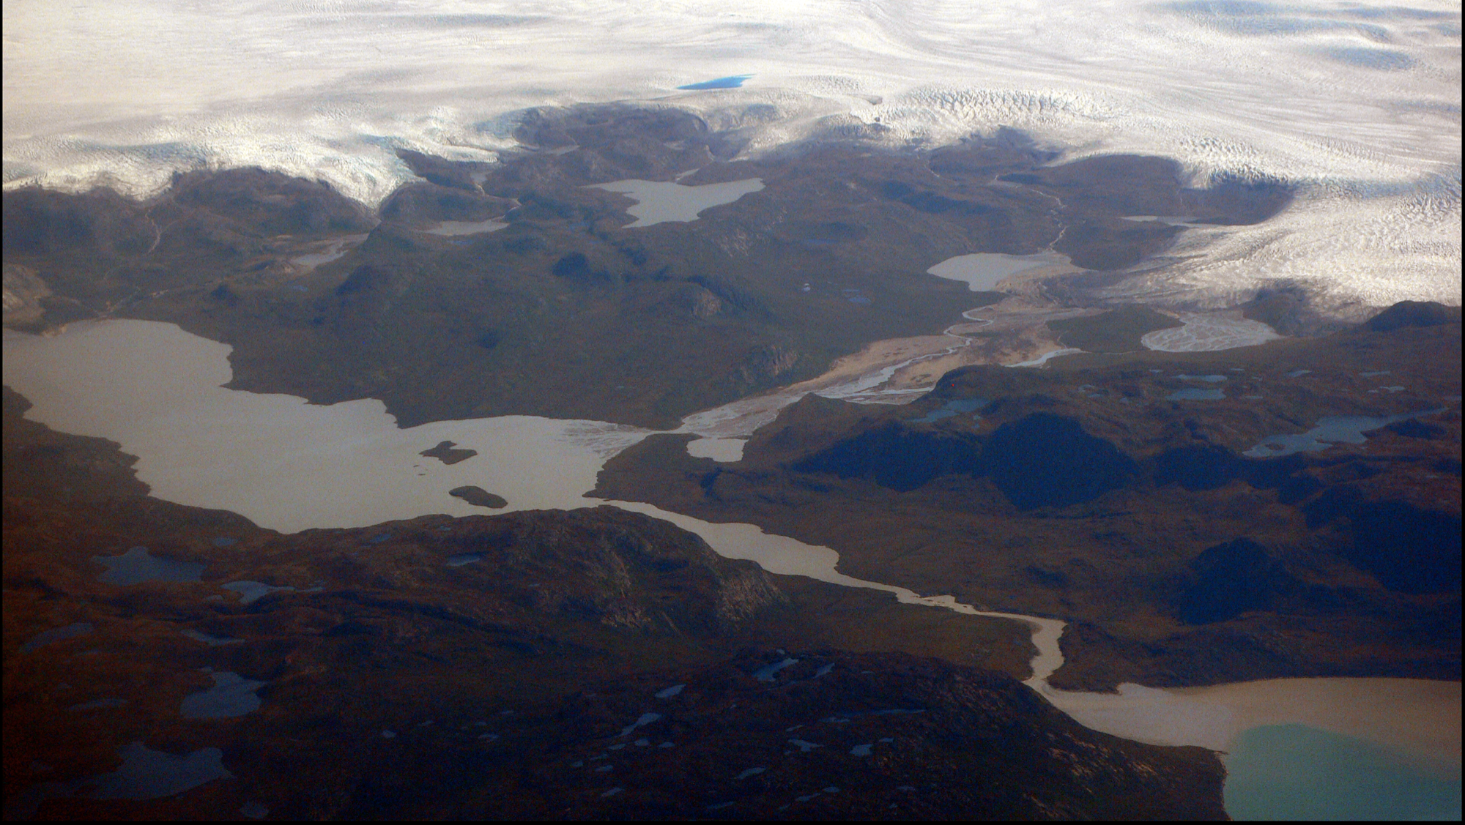
IcyPy: Big data tools for satellite imagery
Ben Hudson
UW APL
4/5/2016

Slide 2
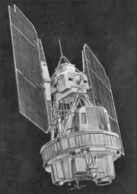
A good problem: An abundance of satellite imagery
The number of earth observing satellites continues to increase
For example high latitudes are imaged at least daily by the MODIS sensor on Aqua and Terra satellites at 250 m resolution
Landsat archive as of 2008 is free, dating back to 1972
Landsat 1

Slide 3
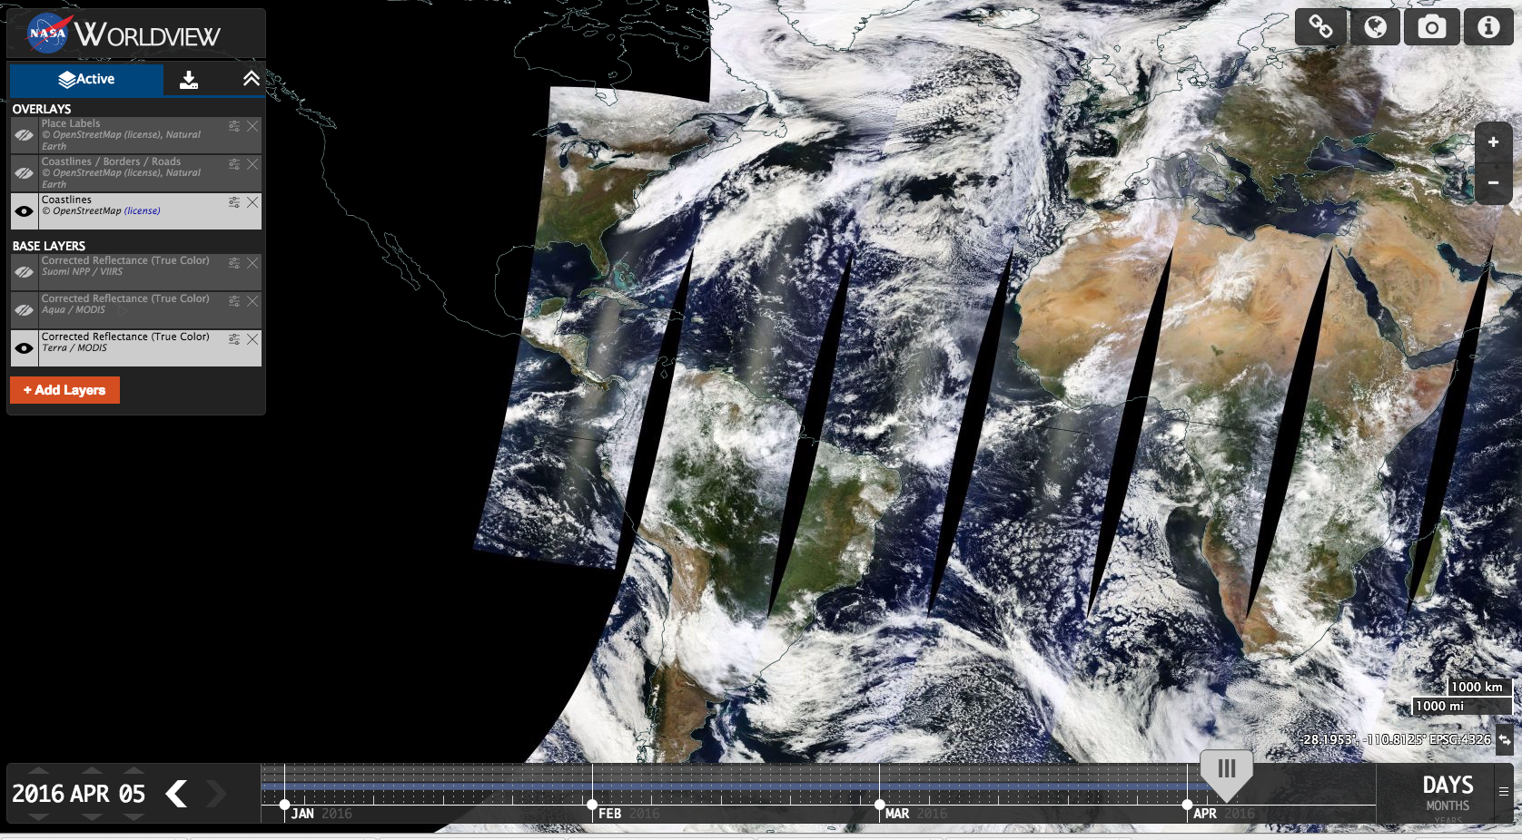

Slide 4
An even bigger data deluge is coming
Google’s Terra Bella pushing the limit of this with HD video from space
https://youtu.be/Bnv-UZa8AyI

Slide 5
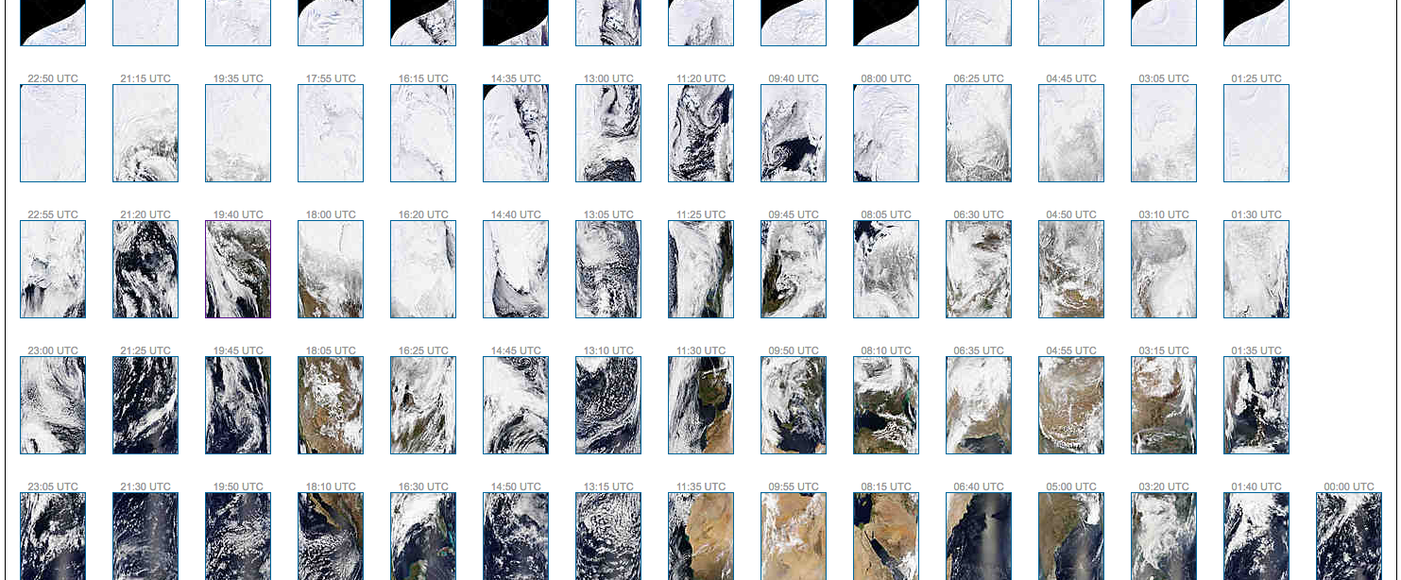
Old way of doing it.

Slide 6
Overview
I am going to talk about 2 different approaches
One in the cloud (Google Earth Engine)
One on your own machine (Numpy + Dask)
Two applications
Monitoring rivers in Greenland (and by extension ice melt)
Probability based estimates of how water flows through an ice sheet
Largely about making things easier…

Slide 7
Google Earth Engine

Slide 8
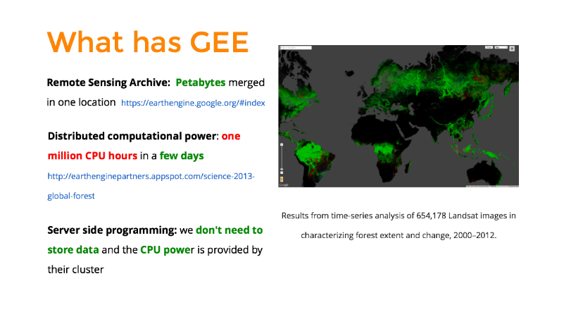
What is GEE
SOURCE: http://www.eomf.ou.edu

Slide 9
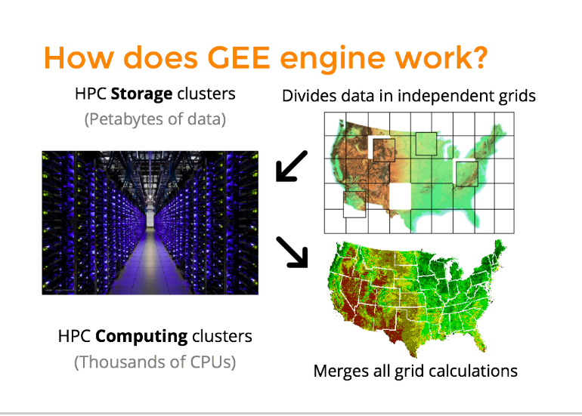
SOURCE: http://www.eomf.ou.edu

Slide 10


Google Earth Engine
Two languages to interact with
JavaScript (more mature)
Python (iPython notebook)

Slide 11
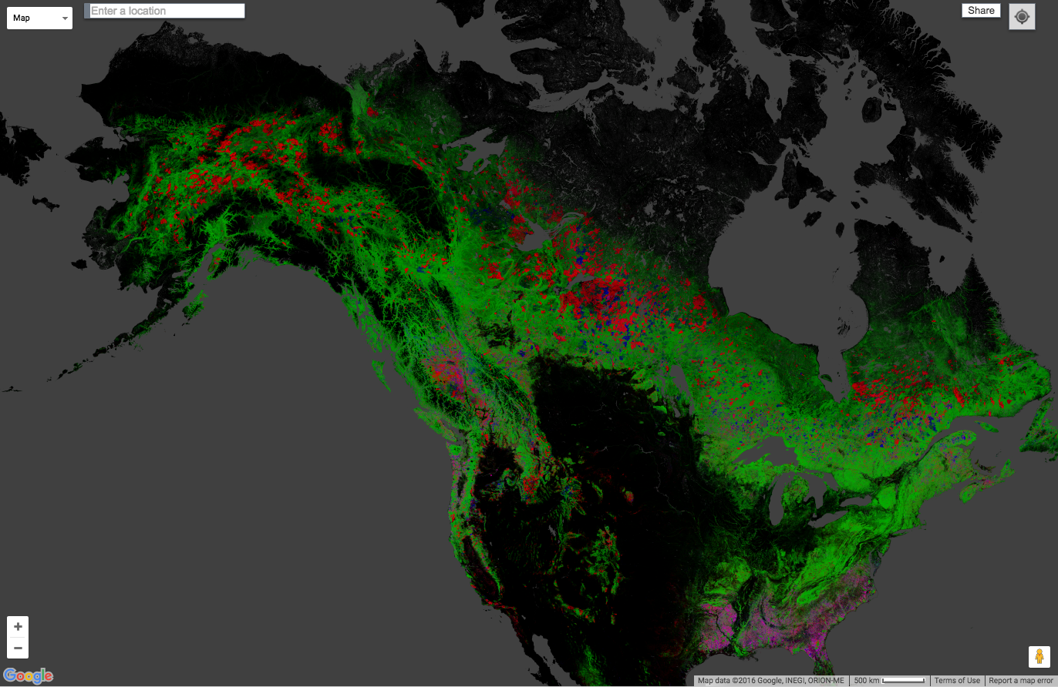
Global scale
https://earthenginepartners.appspot.com/science-2013-global-forest

Slide 12
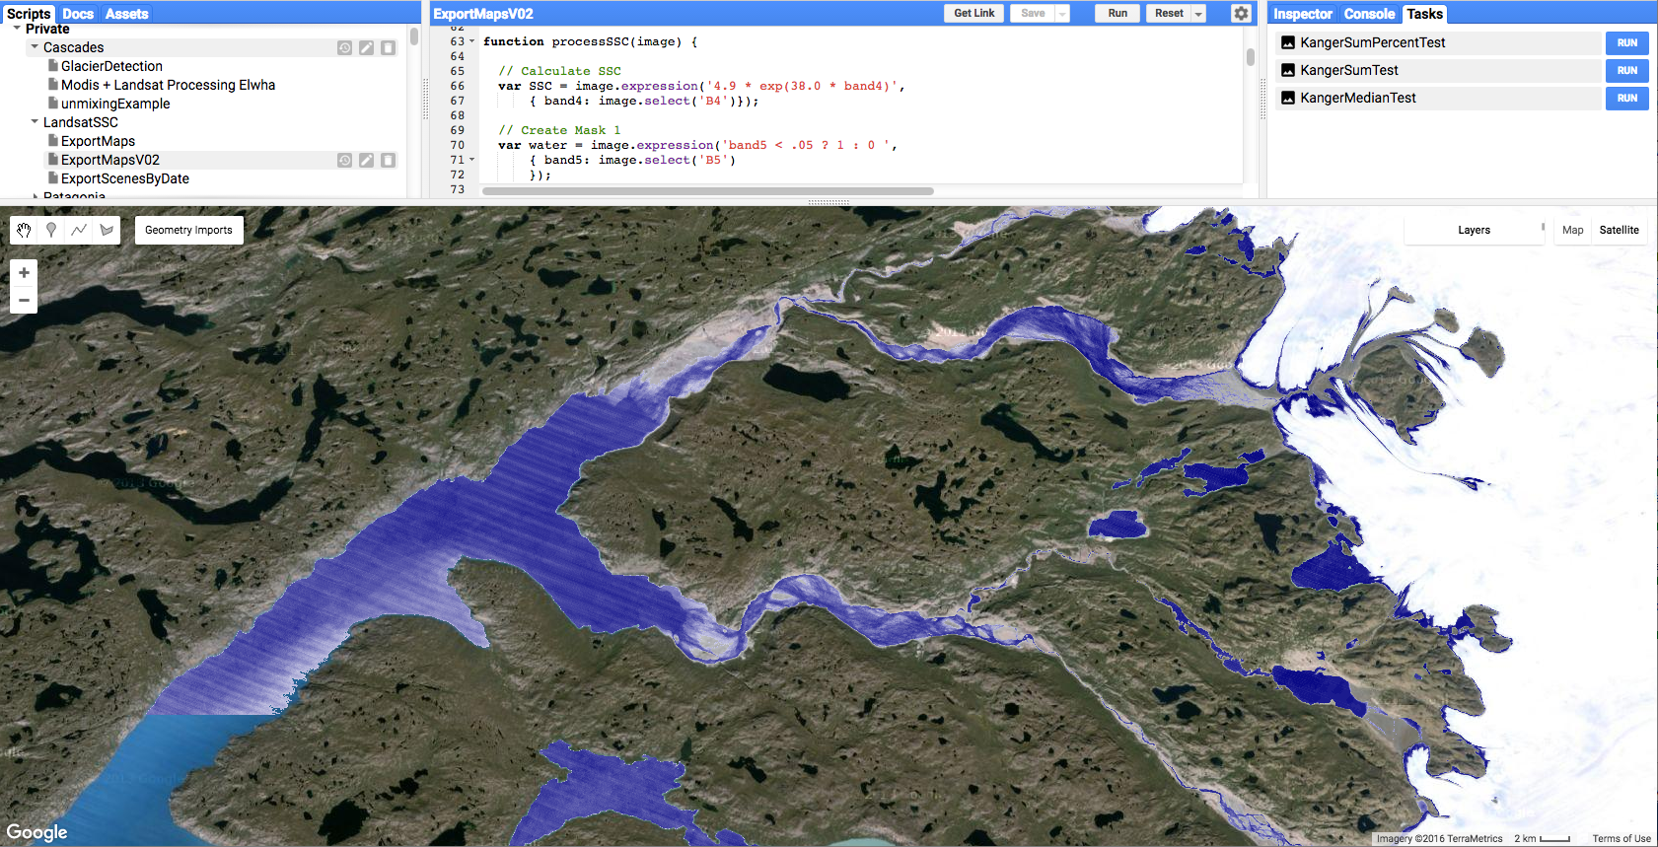
https://code.earthengine.google.com/8b0de847f00aaec7fa6e6de08ddb7ca2

Slide 13
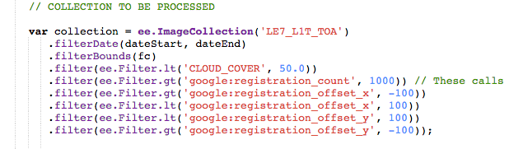
Basic unit is an image/image collection
Most useful unit is an image collection
LE7_L1T_TOA is the Landsat 7 Top of the Atmosphere reflectance
Filters can be applied as needed

Slide 14
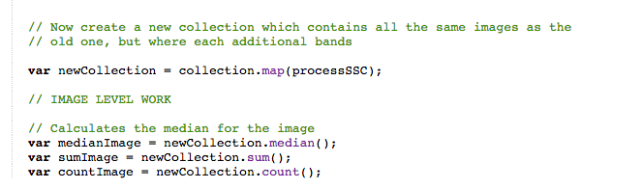
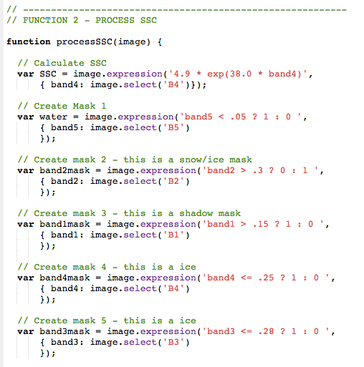
Functions mapped onto image collections
Function --> map
Built in methods such as median

Slide 15
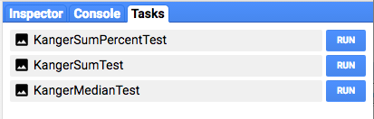
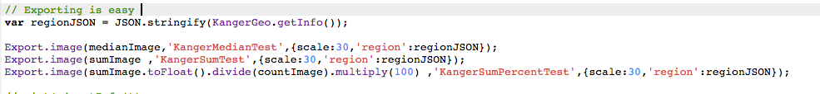
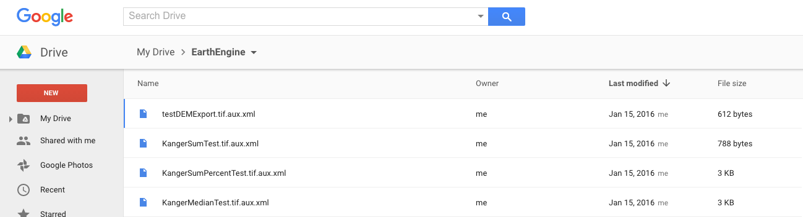
Exporting

Slide 16
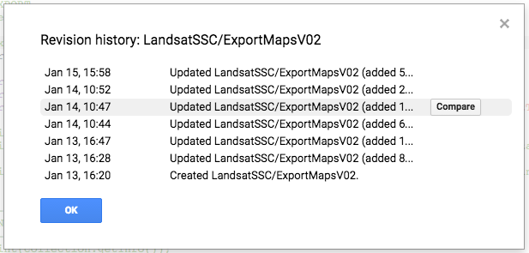
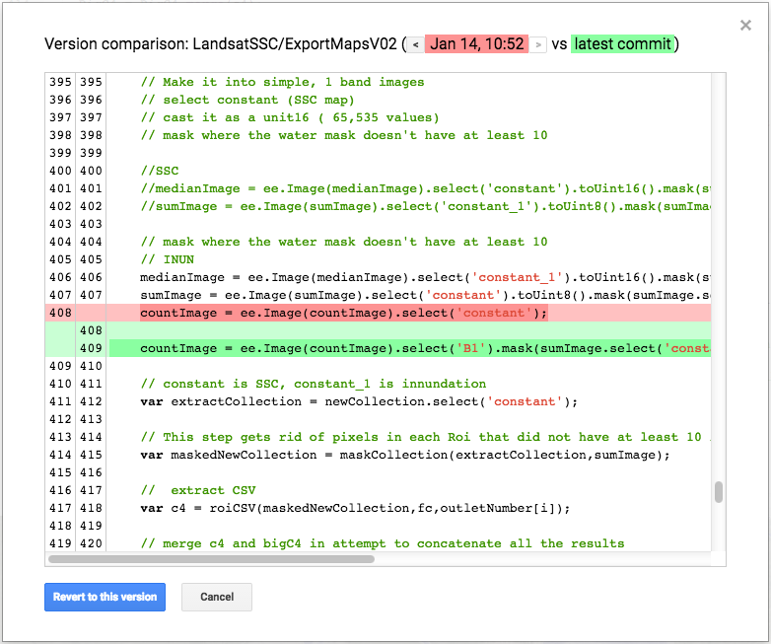
Full version control

Slide 17
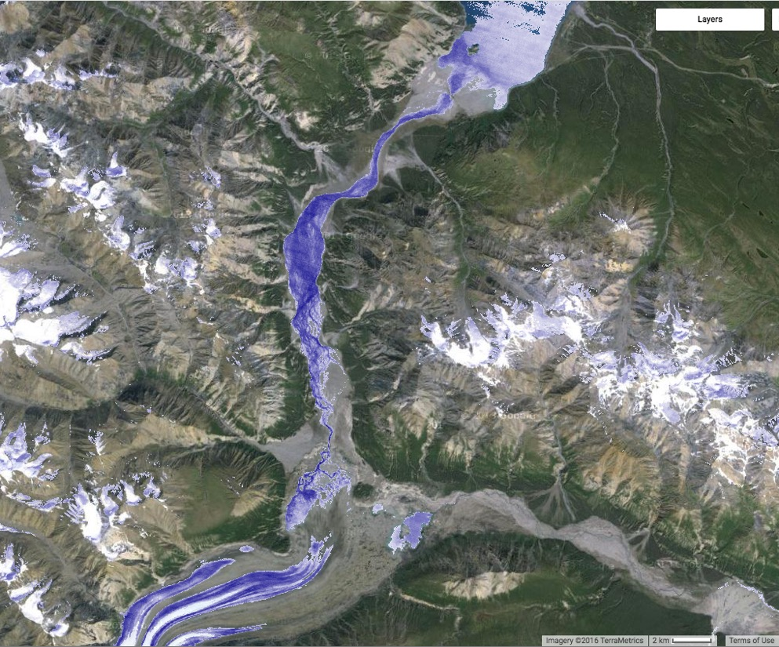
Portable to other parts of the world
Explore collaboration/future field work in the Canadian Yukon with very minor changes to code

Slide 18
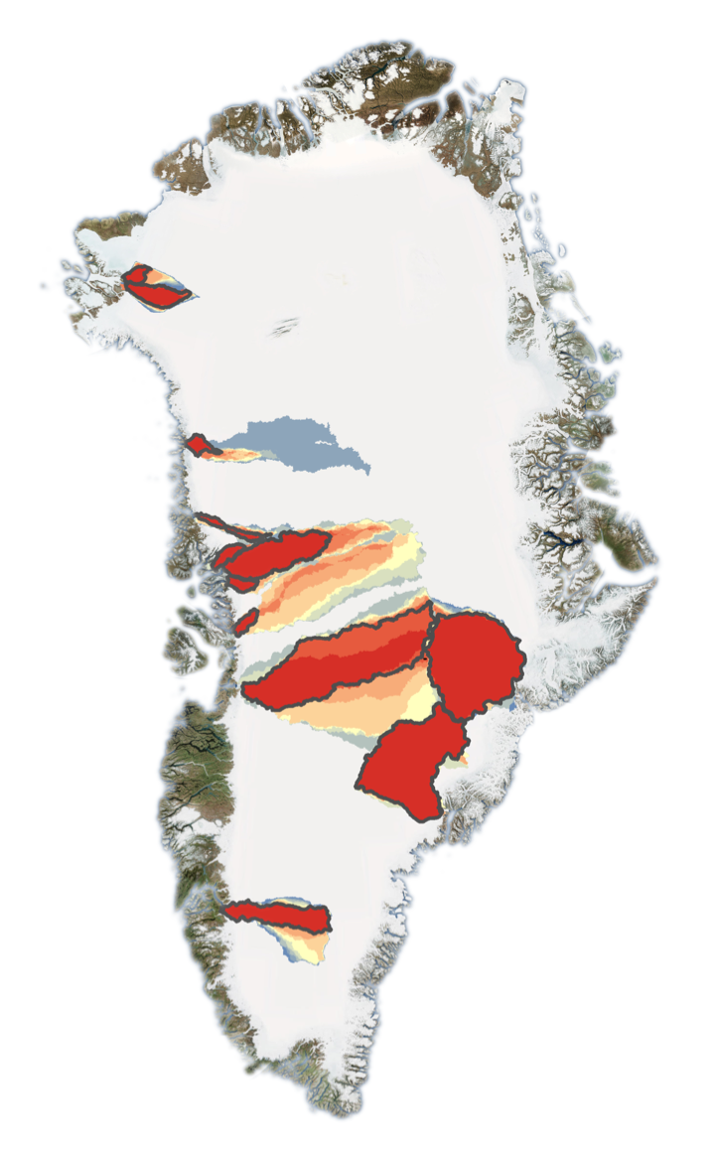
Numpy + Dask
Google Earth engine does not communicate
between tiles
Hydrologic flow routing requires a recursive search
From an outlet to the highest headwaters
Converting old code
Needed C+ library not compatible
Goal: Create probability based maps of where the
water flowing out of the Greenland ice sheet comes
From

Slide 19
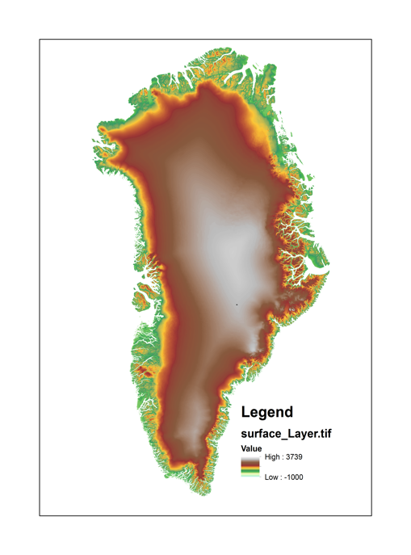

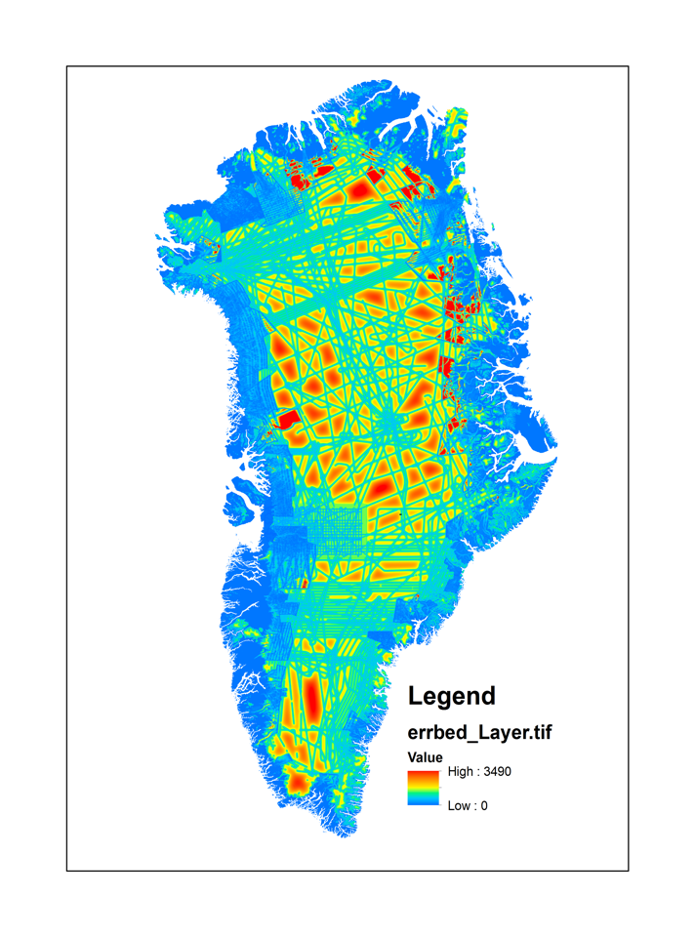
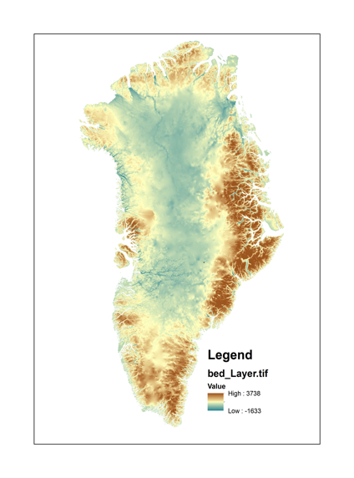

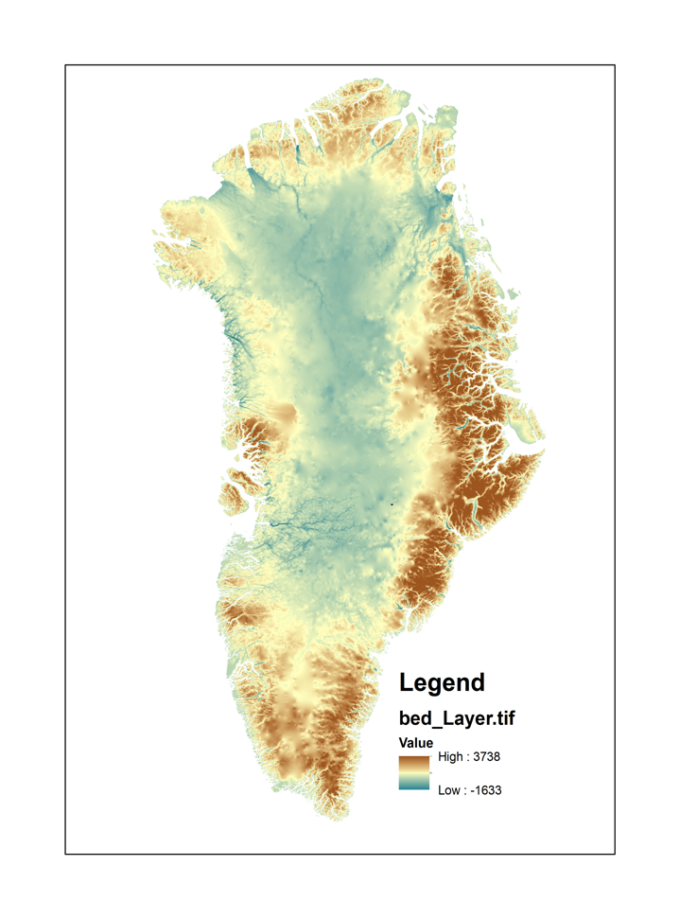

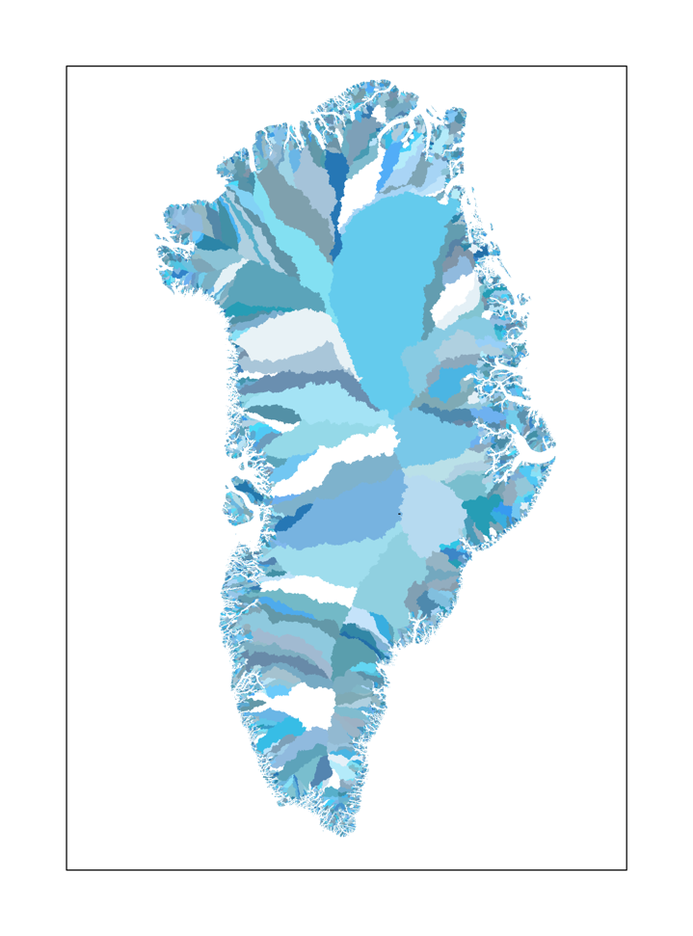
One equation…
To calculate the hydraulic potentiometric surface, φ, we use the basal topography, z_{bed}, and ice surface topography data, z_{ice} (Morlighem et al. 2014).
φ = ρ g (z_{ice}+0.1 z_{bed}) Eq. (1)
Where ρ is the density of ice and g is acceleration due to gravity.
To define a hydrologic catchment I define contributing on-ice catchments to each outlet based on calculations of the local hydrostatic pressure field (Lewis and Smith, 2009; Cuffey and Patterson, 2010). To calculate the hydraulic potentiometric surface, φ, we use the basal topography, z_{bed}, and ice surface topography data, z_{ice} (Morlighem et al. 2014).
φ = ρ g (z_{ice}+0.1 z_{bed}) Eq. (1)
Where ρ is the density of ice and g is acceleration due to gravity.
To define a hydrologic catchment I define contributing on-ice catchments to each outlet based on calculations of the local hydrostatic pressure field (Lewis and Smith, 2009; Cuffey and Patterson, 2010). To calculate the hydraulic potentiometric surface, φ, we use the basal topography, z_{bed}, and ice surface topography data, z_{ice} (Morlighem et al. 2014).
φ = ρ g (z_{ice}+0.1 z_{bed}) Eq. (1)
Where ρ is the density of ice and g is acceleration due to gravity.

Slide 20
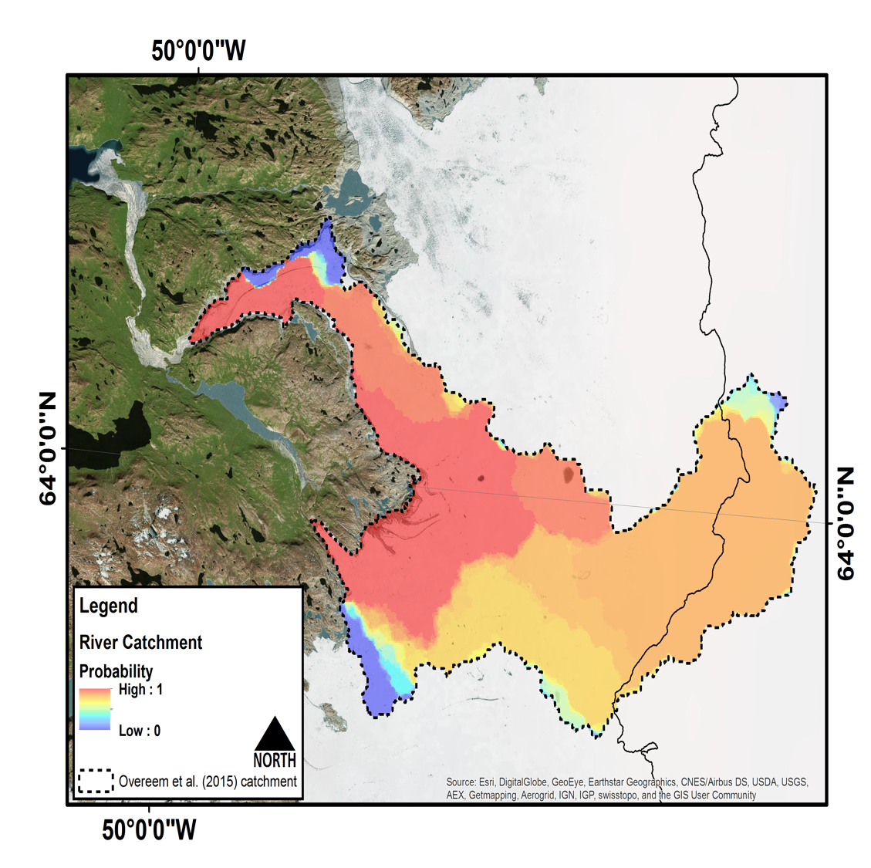
Example Result
Probability that water in river came from this section of the ice sheet
Works well for individual scale
Can it be scaled up to all of Greenland?

Slide 21
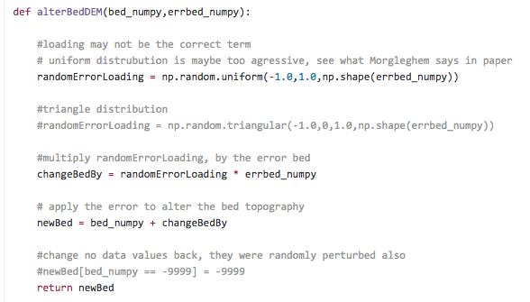
Functions used
https://github.com/BDHudson/GreenlandBasins/blob/master/src/STEP01B_Alternative_MakeBasins.py

Slide 22
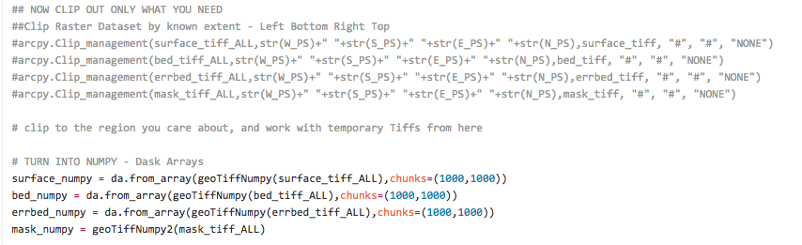
Where I had to clip before, can use Dask

Slide 23
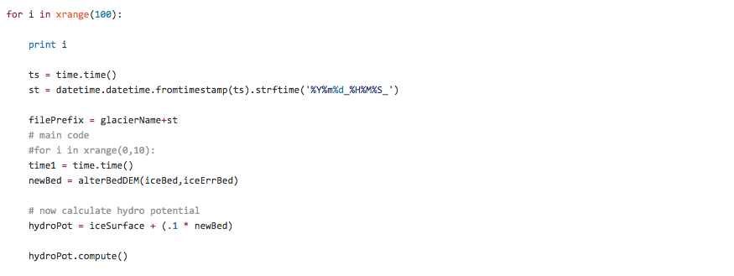
.compute()

Slide 24
Questions?

Slide 25
A good problem: Imagery is too high resolution
Video imagery of rivers to track the flow of water

Slide 26
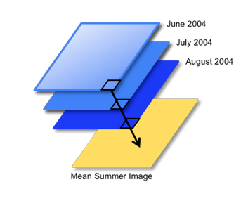
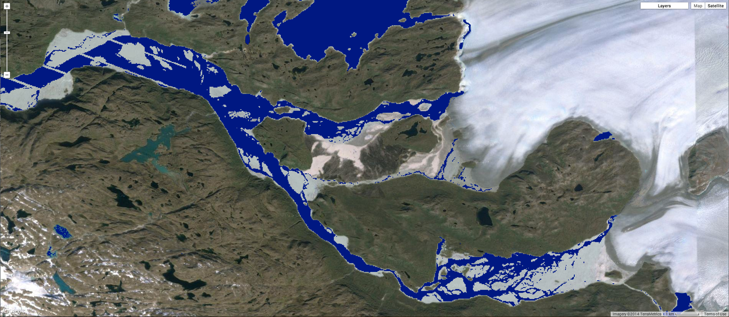
Inundation: One image
Google Inc.

Slide 27
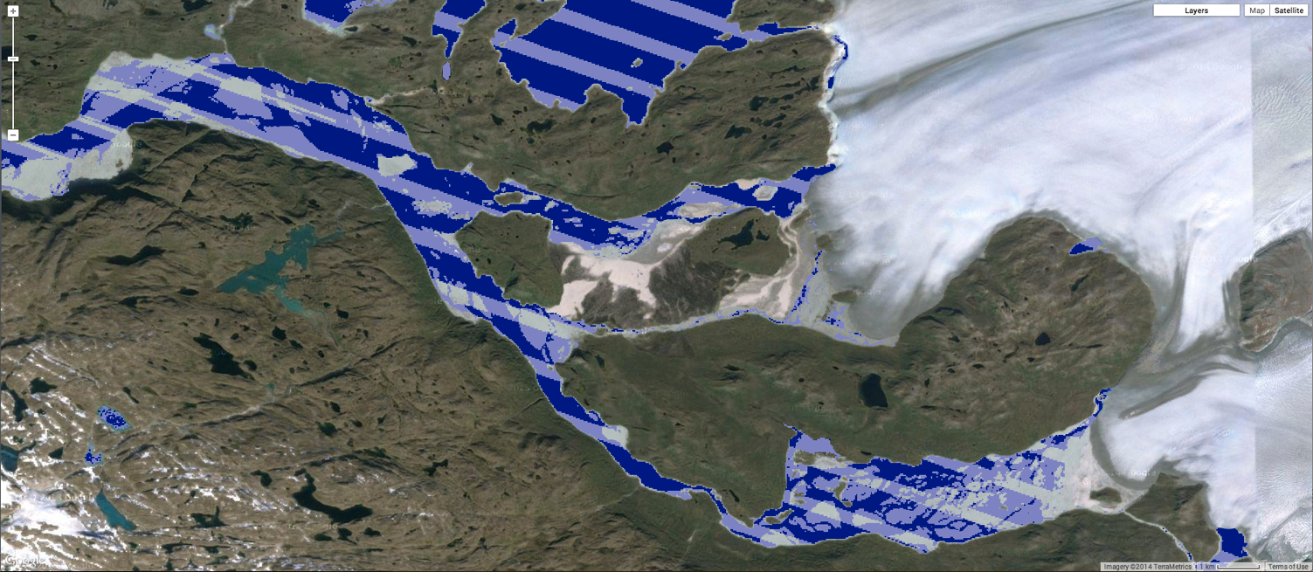
Inundation: Two images
Google Inc.

Slide 28
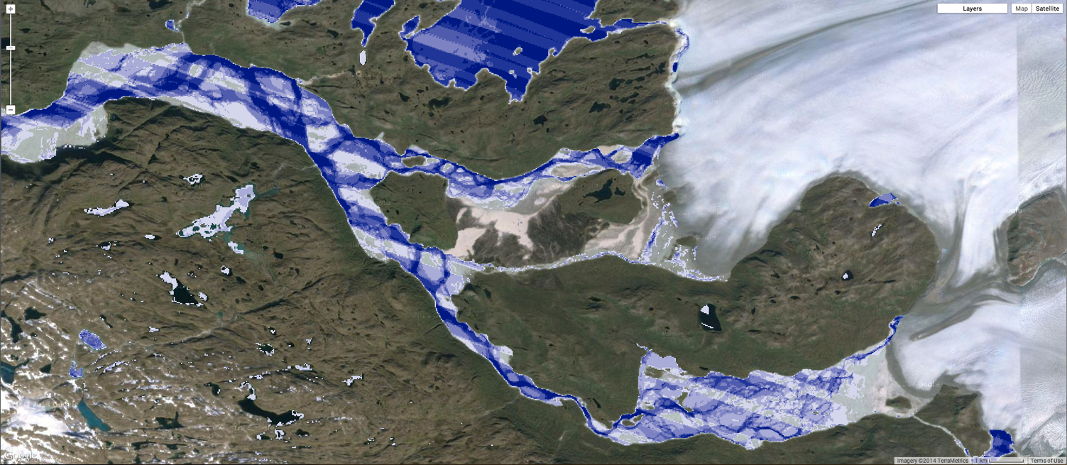
Inundation: Six images
Google Inc.

Slide 29
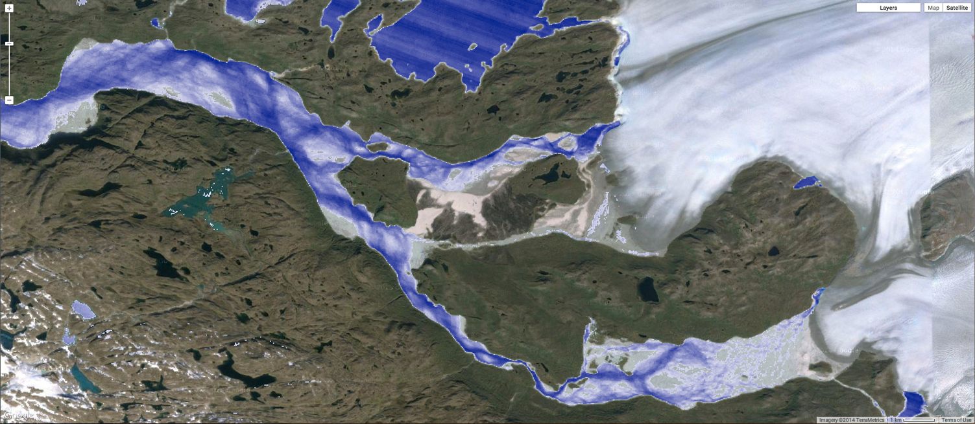
Inundation: 60 images
Google Inc.

